Slide 1
Azure IaaS Fundamentals

Slide 2
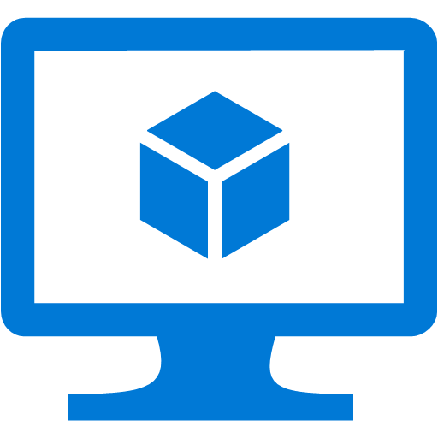
Why use SQL Server in VMs?
Run a full version of SQL Server – all features, all additional services (SSIS, SSAS, SSRS, R)
Scalable VM size
Some built-in HA and maintenance

Slide 3
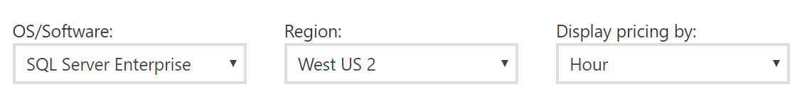
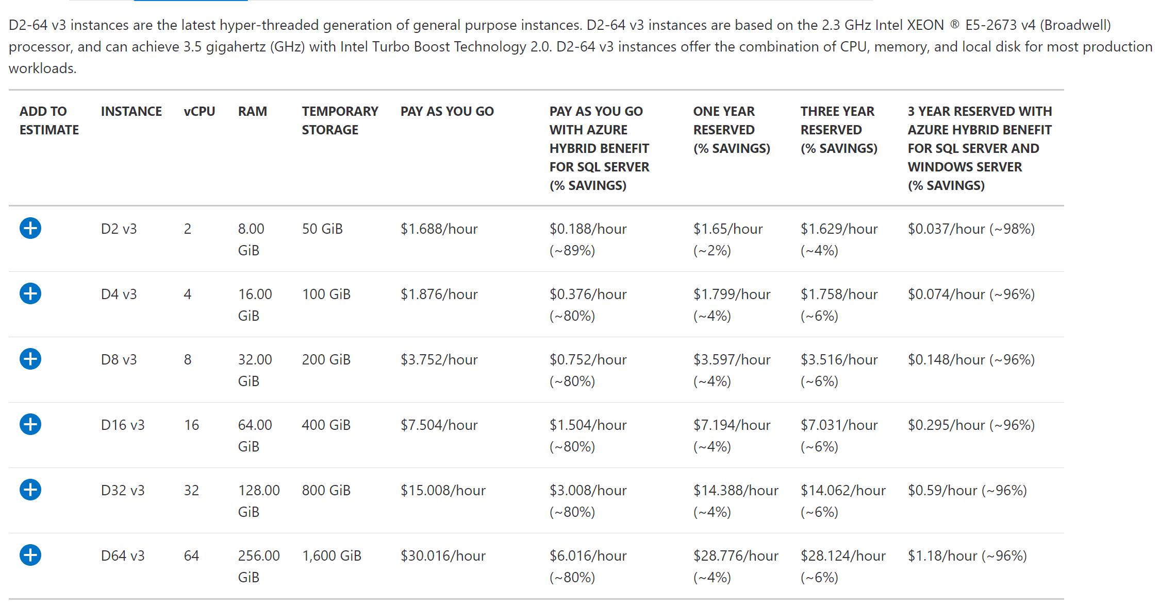
Pricing and Licensing
You’re paying for:
Compute
SQL licensing
Gallery images
Pricing per hour
SQL Server 2008 R2 +
Enterprise, Standard, Web
Bring your own licensing

Slide 4
Development & Testing
There is no "free" tier for testing
Tips for managing costs
Use low-cost VMs with standard (not premium) storage
Use SQL Server Developer Edition (image or BYOL)
Use DevTest Labs
Create reusable templates for VMs
Integrate with your CI tools
Set lab policies for auto start up and shut down times
Set caps on number and size of VMs

Slide 5
Setup and Planning
Performance best practices for SQL Server in Azure Virtual Machines
VM size
Use Premium Storage, geo-replication disabled
Disk recommendations
I/O recommendations
Back up directly to blob storage
https://docs.microsoft.com/en-us/azure/virtual-machines/windows/sql/virtual-machines-windows-sql-performance

Slide 6
Network Security Group
What firewall rules will be applied to the VM?
Set your port (default 1433) for incoming

Slide 7
VM size
There are various series of VMs
A, D, F series
Varied CPU types, counts, memory amounts, OS disk type & sizes
Minimum recommendations
Standard/Web - DS2
Enterprise - DS3
Use premium storage
Notes:
Pull up VM sizes on azure.com

Slide 8
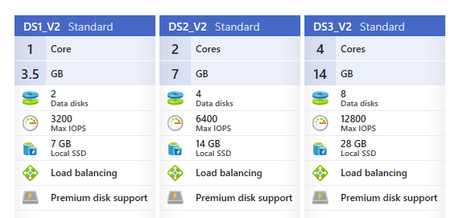
Disks
The VM size determines how many disks you can attach and if they are standard or premium.
The number of disks attached determines how many IOPs the server can perform.

Slide 9
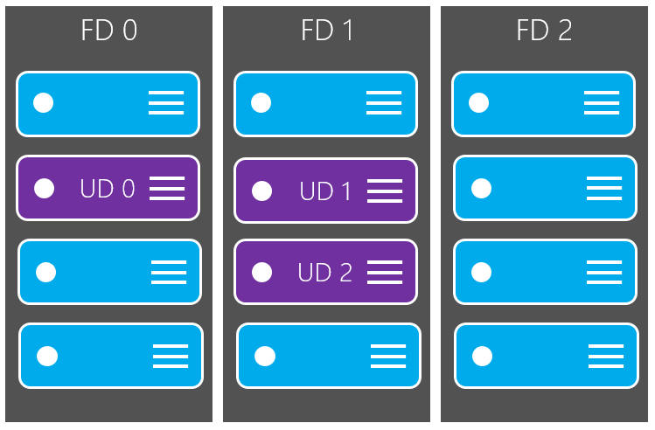
Availability sets
Group two or more VMs in an availability set to provide redundancy
Fault domains - common power source and physical switch.
Update domains - machines in the same update domain are restarted together.
Do I need this if I'm configuring a SQL Server HA method?
Yes. If you create to VMs to add to an AG, for example, this guarantees they will be restarted separately for maintenance.

Slide 10
Workflow
Bring Your Own License
Build VM
Add disks
Install SQL Server
Configure SQL Server
Image Gallery
Build VM
Configure SQL Server

Slide 11
Demo
Portal
PowerShell
Notes:
New-AzureRmVM.ps1

Slide 12
Administration
What's different from on-premises SQL Server?
Backup to URL is recommended
Backing up to blob storage instead of a locally-attached disk

Slide 13
Demo
Backup to URL
Notes:
File is in demos, and on SQL2016D

Slide 14
Scaling
You can change your VM size - larger or smaller.
Increase capacity when load increases; decrease size and costs when under-utilized.
Is everything online?
Yes, if the region and cluster have the available resources.
If you attempt to resize a VM and get an allocation error, you need to shut down, resize, and restart.
If you have multiple VMs in an Availability Set, you need to shut down, resize, and restart all of them.
Resize a Windows VM https://docs.microsoft.com/en-us/azure/virtual-machines/windows/resize-vm

Slide 15
Demo
Portal
PowerShell
Notes:
Change Azure vm size.ps1

Slide 16
High Availability
What's supported in Azure?
Availability Groups
Create multiple Azure VMs and set up an AG
Can be sync or async
Requires a domain controller VM (unless you're using domain-independent AGs with Windows Server 2016 & SQL Server 2016)
Failover Cluster Instances
Attached storage using Windows Server 2016 Storage Spaces Direct (S2D) to provide a software-based virtual SAN.
Storage supported by a third-party clustering solution - SIOS DataKeeper.
A two-node failover cluster running in Azure VMs with remote iSCSI Target shared block storage via ExpressRoute. (For example, NetApp Private Storage (NPS) exposes an iSCSI target via ExpressRoute with Equinix to Azure VMs.)
Database Mirroring
Notes:
https://docs.microsoft.com/en-us/azure/virtual-machines/windows/sql/virtual-machines-windows-sql-high-availability-dr

Slide 17
Disaster Recovery
What's supported in Azure?
Cross-region Availability Groups
Asynchronous
Manual failover
Requires vnet-to-vnet connectivity
Database Mirroring
Asynchronous
Use certificates, not AD
Backup and restore
DR is intended to protect you if you lose connectivity to a region, so ensure your backups are in more than one region!
The storage for your backups should be set up with GRS.
Notes:
https://docs.microsoft.com/en-us/azure/virtual-machines/windows/sql/virtual-machines-windows-sql-high-availability-dr
AGs: https://docs.microsoft.com/en-us/azure/virtual-machines/windows/sql/virtual-machines-windows-portal-sql-availability-group-dr

Slide 18
Security: Access
Access to the database goes through several layers, including the vnet, the subnet, and the NSG.
Make sure each is configured properly to allow applications through, but nothing else.
Database credentials can be configured to use AD or SQL authentication.
When using a SQL Server image from the gallery, you choose the authentication method.
When using BYOL, you decide during setup.

Slide 19
Security: Data
No changes from on-premises
Supported features
Column-level encryption
Backup encryption
Transparent Data Encryption
Always Encrypted

Slide 20
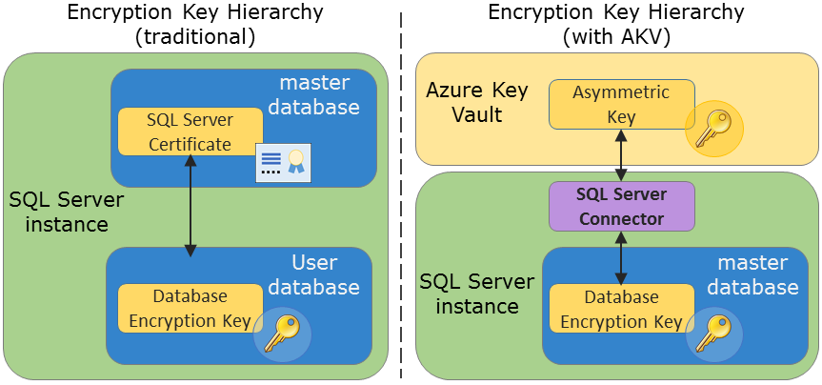
Azure Key Vault
Store encryption keys outside of SQL Server, providing an extra layer of security.
Compatible with
Column-level encryption
Backup encryption
Transparent Data Encryption
Notes:
https://docs.microsoft.com/en-us/sql/relational-databases/security/encryption/extensible-key-management-using-azure-key-vault-sql-server

Slide 21
Migrating data
Want to move your data from on-premises to Azure?
Join an AG replica
Transactional replication
Log shipping
Restore a backup
Create a Hyper-V VHD & import
Windows Import/Export services
Least down time
Most down time
Notes:
https://docs.microsoft.com/en-us/azure/virtual-machines/windows/sql/virtual-machines-windows-migrate-sql

Slide 22
Join an AG replica
Create a VM in Azure
Join to an existing Availability Group
Requires AD in Azure, synced with on-prem AD
Requires a multi-subnet AG
Initially, set to asynchronous
When ready to move
Set mode to synchronous
Wait for synchronized
Fail over to Azure
Pros
Can sync well ahead of time, yet fail over in predetermined time
Can have VM be lower tier until movement
Can have node be readable secondary for testing
Application connects to listener, so no application changes are necessary
Cons
All nodes must be SQL Server Enterprise Edition
Unless using SQL Server 2016 Standard, which limits you to one database per AG
All non-database objects must be synced separately
Logins, Jobs, Linked Servers

Slide 23
Transactional replication
Create a VM in Azure
Set up replication
Publisher - on-premises
Distributor - on-premises
Subscriber - Azure
When ready to move
Stop application updates
Make sure all transactions have been replicated
Point application to subscriber
Pros
If you only need to move a subset of data, replication allows you to do so
Cons
Replication is complicated
Replication to Azure is more complicated - you need to allow incoming traffic to your VM, and set up the subscriber correctly
Application connection strings need to change to point to new server
All non-database objects must be synced separately
Logins, Jobs, Linked Servers

Slide 24
Log shipping
Create a VM in Azure
Initialize database with full backup and restore
Set up log shipping
When ready to move
Stop application updates
Take a tail-of-the-log backup
Copy all log backups to Azure VM
Restore all log backups to Azure VM
Point application to Azure VM
Pros
Log shipping is a long-standing, easy-to-use feature
You can set backup and restore times to short windows (1-5 minutes) for a very quick cutover
Cons
Application connection strings need to change to point to new server
All non-database objects must be synced separately
Logins, Jobs, Linked Servers
A large number of databases on the same instance set up to log ship can be difficult

Slide 25
Restoring backups
Stop application updates
Copy and use
Take a backup using compression
Move backup to Azure blob storage, using
Azure Storage Explorer
PowerShell
Restore the backup
Backup to URL
Back up directly to Azure storage
Use compression
Restore from Azure storage
Pros
Very simple - script everything ahead of time and run scripts.
No data loss if application connections are shut down and a tail-of-the-log backup is done.
Cons
Depending on the database size, it could take a long time - both to transfer the files into Azure, and to restore them. Best for small databases, or migrations with sufficient down time planned.
Application connection strings need to change to point to new server
All non-database objects must be synced separately
Logins, Jobs, Linked Servers

Slide 26
Create a Hyper-V VHD & import
Use Microsoft Virtual Machine Converter to make physical or virtual machines Hyper-V VHDs
https://technet.microsoft.com/library/dn873998.aspx
Upload VHD to Azure using PowerShell - Add-AzureVHD
https://docs.microsoft.com/en-us/powershell/module/Azure/Add-AzureVhd?view=azuresmps-4.0.0
Pros
If all necessary information is on the VHD - SQL Server files, database, logins, etc. - then no work is needed to migrate anything outside the database.
Cons
Depending on the VHD size, it could take a long time to transfer the files into Azure.
Application connection strings need to change to point to new server.

Slide 27
Windows Import/Export service
You ship hard drives to an Azure data center
A job you create will run once drives are received
No SLA
https://docs.microsoft.com/en-us/azure/storage/storage-import-export-service
Pros
The best choice for large data sets.
Cons
The slowest choice, with no SLA.

Slide 28
Hybrid solutions
Using Azure VMs for DR
Add AG replica
Create a VM in Azure
Join to an existing AG
Requires AD in Azure, synced with on-prem AD
Requires a multi-subnet AG
Set mode to asynchronous

Slide 29
DMA (Data Migration Assistant)
A tool available to help you
Migrate a database to Azure SQL Database
Upgrade an on-premises SQL Server (replaces the Upgrade Advisor)
Migrate an on-premises SQL Server to an Azure VM

Slide 30
Demo
Notes:
Open up on SQL2016D

Slide 31


Performance Tuning
What's different from on-prem? Nothing.
Indexes
Statistics
In-Memory OLTP
DMVs
Extended Events

Slide 32
Monitoring
Tools to monitor the VM
Basic metrics are in the Portal GUI – not easily automated
Azure Monitor
Metric Alerts – get notified if a metric crosses a threshold - https://docs.microsoft.com/en-us/azure/azure-monitor/platform/alerts-metric-overview
Log Analytics virtual machine extension for Windows - https://docs.microsoft.com/en-us/azure/virtual-machines/extensions/oms-windows
Tools to monitor SQL Server health, performance
What's different from on-prem? Nothing.

